Slide 1
PROJECT TITLE :
REAL-TIME SIGN LANGUAGE RECOGNITION USING FINGER-MOUNTED SENSORS AND ML
Supervisor: Dr. Valarmathi. R
Co-supervisor: Dr. Ghousiya Begum

Slide 2
INTRODUCTION TO THE PROJECT: SMART GESTURE RECOGNITION SYSTEM
Introduction
Technology as an integral part of modern life.
Significant strides in human-computer interaction.
Project Focus
Development of a Smart Gesture Recognition System.
Facilitates user interaction with electronic devices through hand gestures.
Primary Objective
Create a user-friendly and efficient system.
Enable seamless control of electronic devices using hand gestures.
Technological Approach
Leverage the power of sensors and machine learning algorithms.
Interpret predefined gestures.
Convert gestures into actionable commands.
Benefits
Eliminate the need for physical input devices such as keyboards or remote controls.
Enhance user convenience and accessibility.
Application Scope
Applicable in various domains like smart homes, healthcare, and assistive technology.
Potential to improve the quality of life for individuals with disabilities.

Slide 3
OBJECTIVE TO THE PROJECT: DEVELOP A SMART GESTURE RECOGNITION SYSTEM
Accurate Gesture Recognition
Develop algorithms to accurately recognize and interpret hand gestures.
Sensor Integration
Integrate advanced sensors (such as accelerometers, gyroscopes, and cameras) to capture precise data about hand movements.
Machine Learning Model Training
Train machine learning models using labeled gesture data to classify and interpret gestures effectively.
Wireless Communication
Implement wireless communication protocols (such as Bluetooth or Wi-Fi) to enable seamless device control.
Intuitive User Interface
Design a user-friendly interface that allows users to easily interact with the system and control devices using gestures.
Versatility
Ensure the system's versatility to accommodate various applications, including smart home control, gaming, virtual reality, and more.

Slide 4
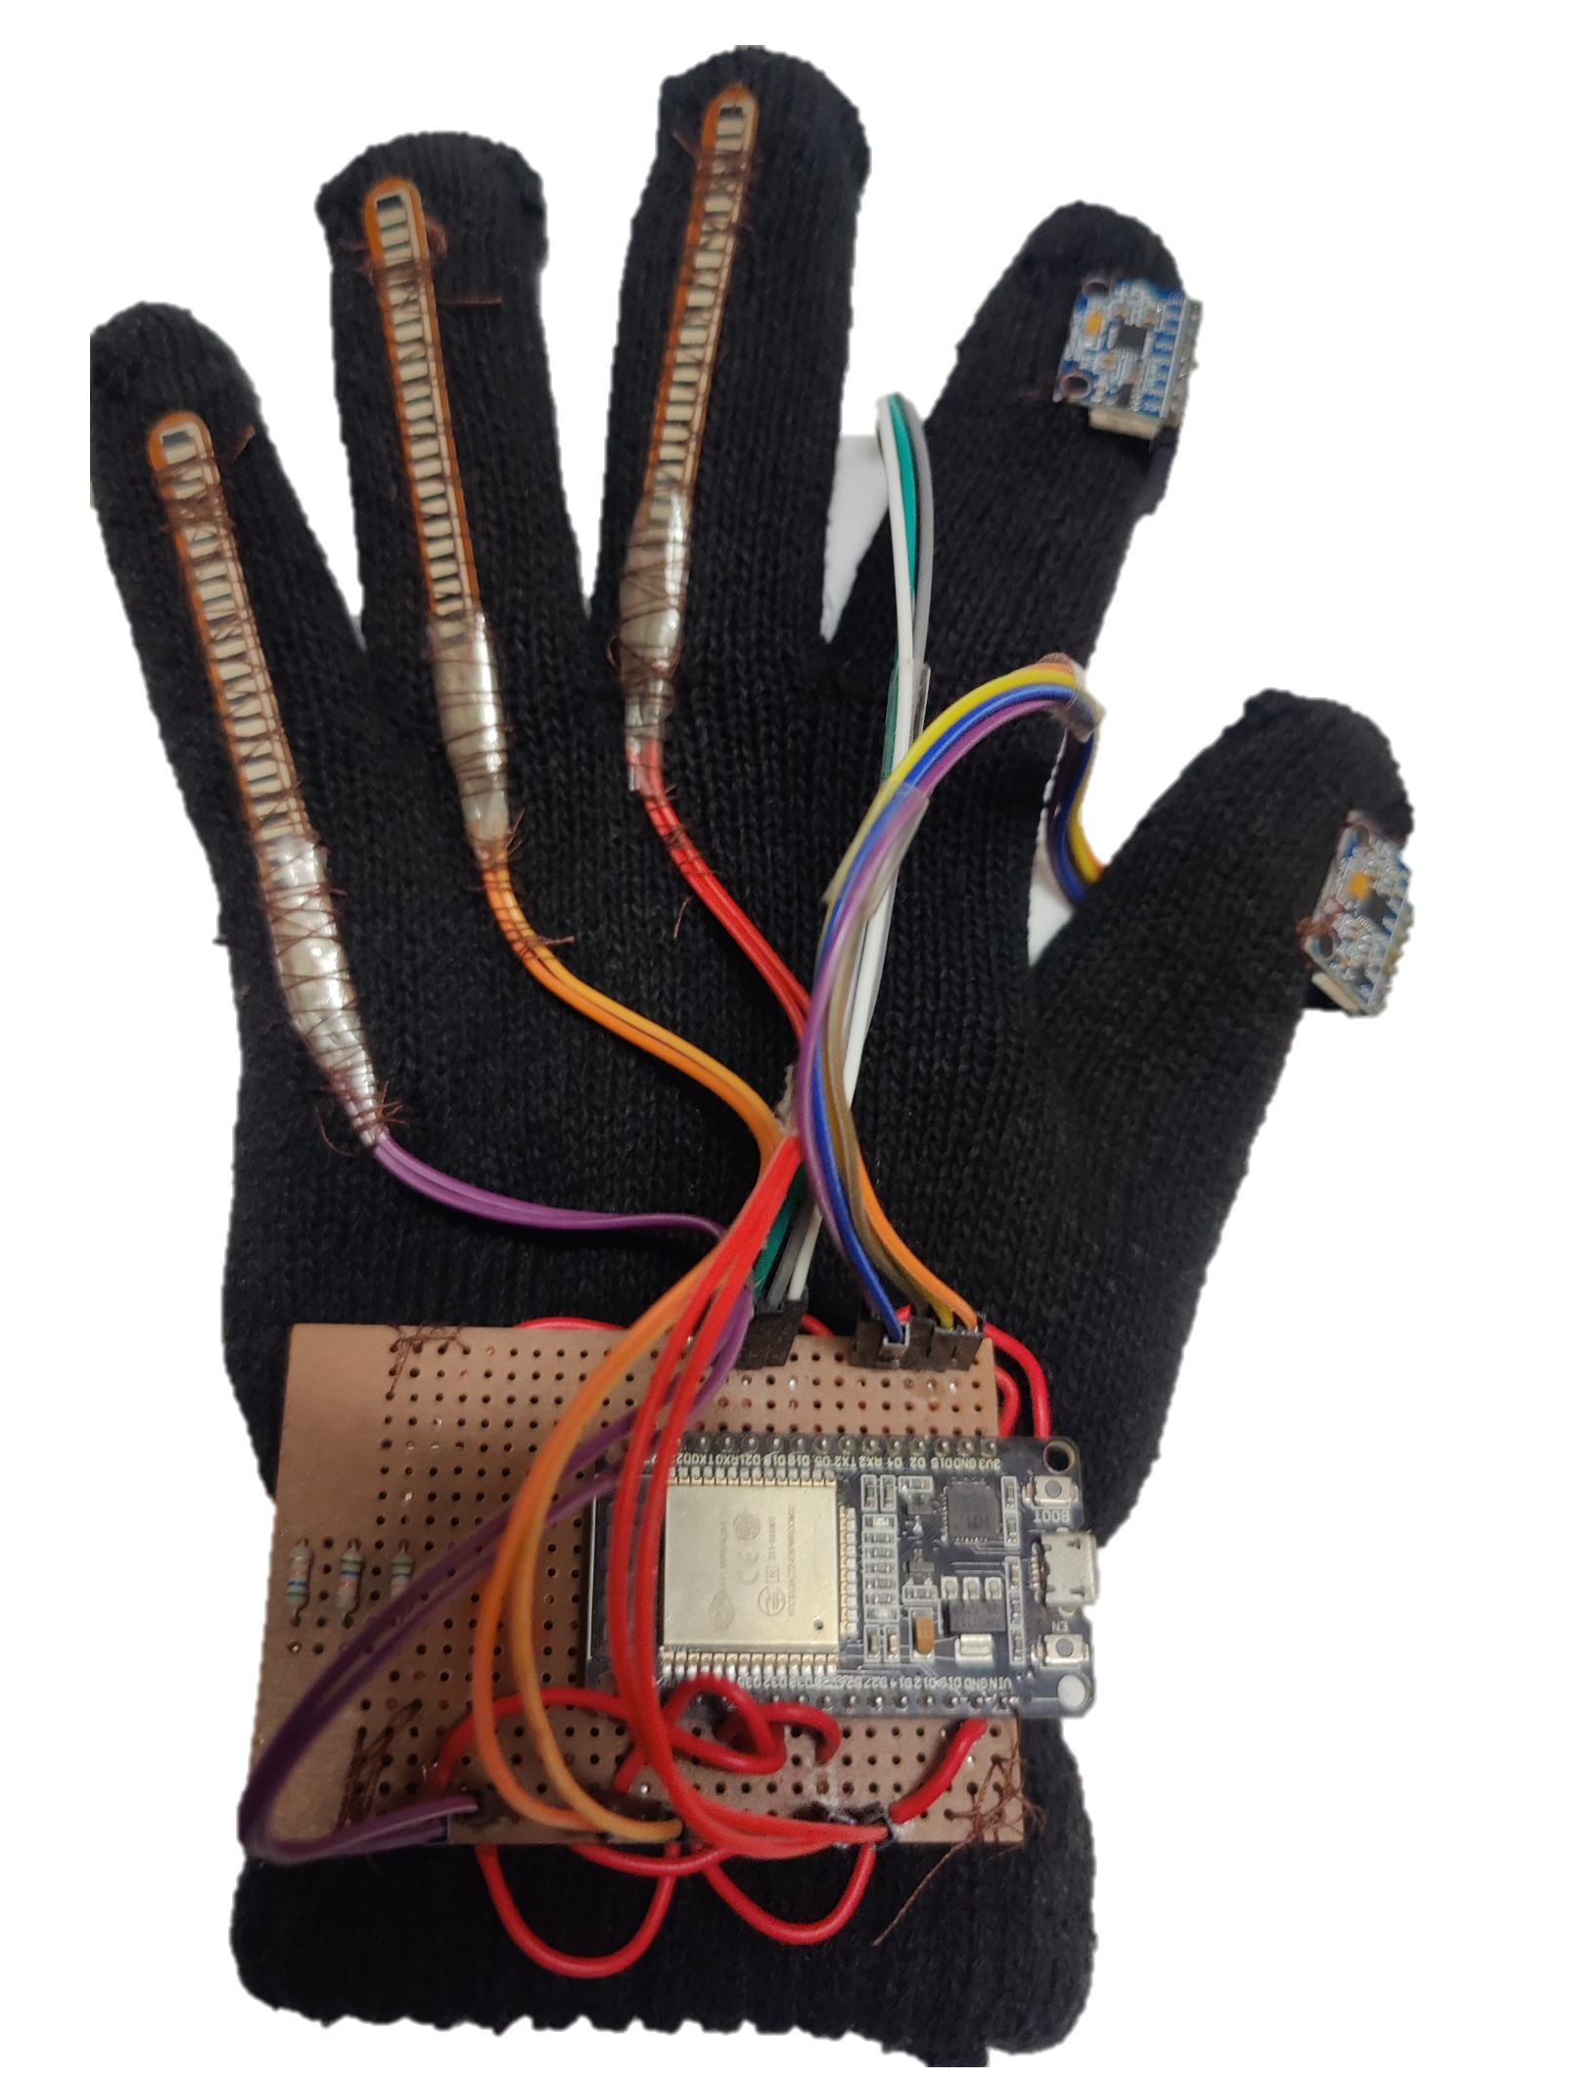
HARDWARE PART :
FLEX SENSOR 1
FLEX SENSOR 2
IMU 1
FLEX SENSOR 3
IMU 2
Node MCU

Slide 5
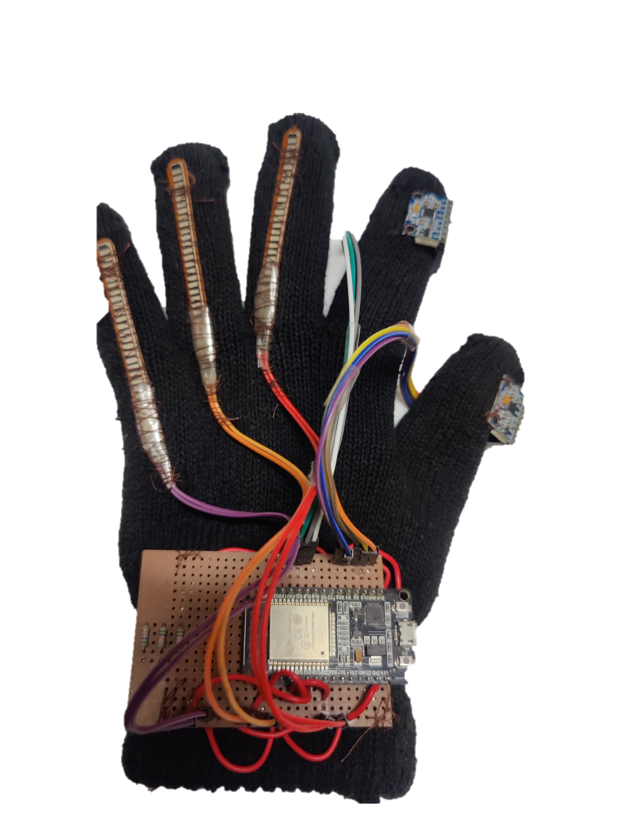
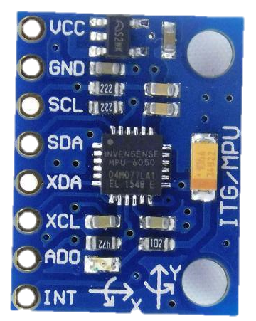
HARDWARE PART :
MPU6050 Sensor
integrated Functionality
Combines gyroscope and accelerometer functionalities in a single chip.
Provides precise measurements of motion, orientation, and acceleration.
FLEX SENSOR 1
FLEX SENSOR 2
IMU 1
Three-Dimensional Capabilities
Enables accurate tracking of motion in three-dimensional space.
Measures rotational motion (roll, pitch, yaw) and acceleration along three axes (X, Y, Z).
FLEX SENSOR 3
IMU 2
Versatile Applications
Widely used in robotics, drones, motion tracking systems, and wearable devices.
Offers comprehensive motion analysis for various applications requiring precise motion sensing.
Node MCU

Slide 6
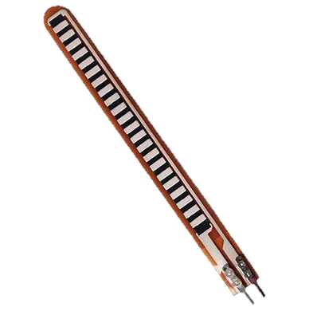
Resistive Sensor
Flex sensor is a type of resistive sensor.
Its resistance changes when it is bent.
HARDWARE PART : FLEX SENSOR
FLEX SENSOR 1
FLEX SENSOR 2
IMU 1
Flexible Substrate
Consists of a flexible substrate, usually made of plastic or rubber.
Infused with conductive particles that enable electrical conductivity.
FLEX SENSOR 3
IMU 2
Resistance Alteration
Bending the sensor changes the distance between conductive particles.
This alteration in distance alter the resistance of the sensor, providing a measure of the degree of bending
Node MCU

Slide 7
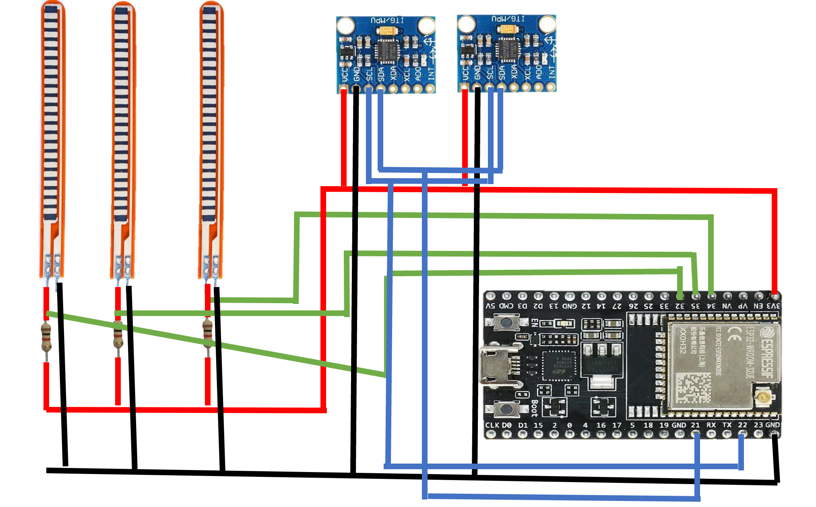
FLEX SENSOR 1
FLEX SENSOR 2
IMU 1
FLEX SENSOR 3
IMU 2
HARDWARE PART : Circuit diagram of the hardware
Node MCU
Components
Two MPU6050 IMU sensors for capturing motion data of the index and thumb fingers.
Three flex sensors for detecting the movement of the remaining fingers.
Circuit Diagram Overview
MPU6050 IMU sensors are connected to the index and thumb fingers.
Flex sensors are connected to the remaining fingers.
Connections
MPU6050 IMU sensors are interfaced with the microcontroller using I2C communication protocol.
Flex sensors are connected to analog input pins of the microcontroller.

Slide 8
HARDWARE PART : DATA FROM HARDWARE
Flex Sensors:
Finger 1 (Index Finger): Flex Sensor 1
Finger 2 (Thumb): Flex Sensor 2
Finger 3 (Middle Finger): Flex Sensor 3
Finger 4 (Ring Finger): Flex Sensor 4
Finger 5 (Little Finger): Flex Sensor 5
Acceleration (First Sensor):
a1x: X-axis
a1y: Y-axis
a1z: Z-axis
Angular Velocity (Second Sensor - Gyroscope Data):
g2x: X-axis
g2y: Y-axis
g2z: Z-axis
MPU6050 Sensors:
Hand Orientation (First Sensor):
Pitch1
Roll1
Yaw1
Hand Orientation (Second Sensor):
Pitch2
Roll2
Yaw2
Angular Velocity (First Sensor - Gyroscope Data):
g1x: X-axis
g1y: Y-axis
g1z: Z-axis
Acceleration (Second Sensor):
a2x: X-axis
a2y: Y-axis
a2z: Z-axis

Slide 9
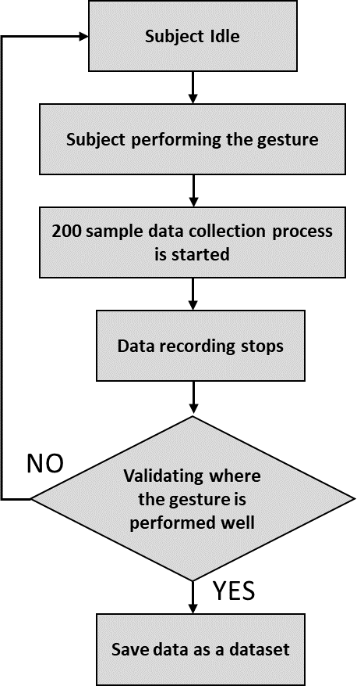
HARDWARE PART : DATA COLLECTION PROCESS

Slide 10
Machine learning – Part:
Model | Training Accuracy | Testing Accuracy
Random Forest | 99.72% | 99.53%
SVM | 99.55% | 99.36%
KNN | 99.42% | 99.29%
Decision Tree | 99.32% | 99.29%
Logistic Regression | 99.59% | 99.50%

Slide 11
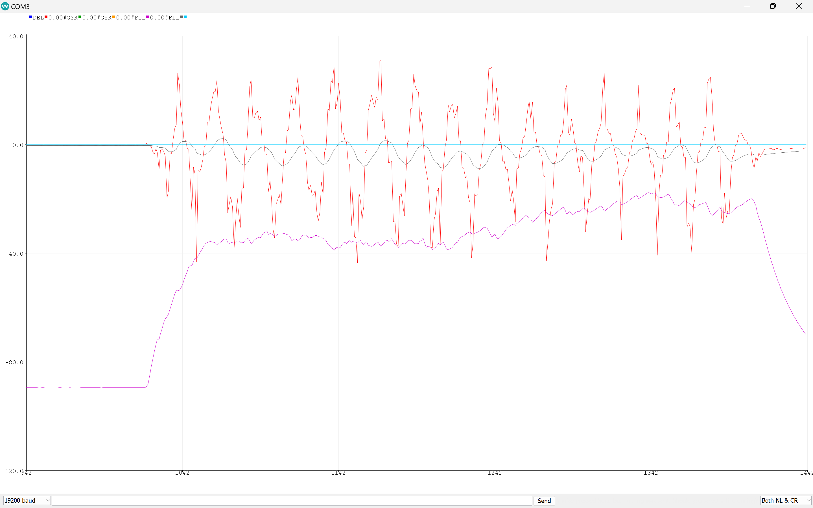
Machine learning – Part:

Slide 12
Machine learning – Part:
finger 1 | finger 2 | finger 3 | finger 4 | finger 5 | pitch1 | roll1 | yaw1 | pitch2 | roll2 | yaw2 | a1x | a1y | a1z | g1x | g1y | g1z | a2x | a2y | a2z | g2x | g2y | g2z
68 | 52 | 96 | 0 | 30 | 1.77 | 31.32 | 92.08 | -75.73 | 74.46 | 3.9 | -0.27 | 4.46 | 7.33 | -0.08 | 0.08 | -0.22 | 9.2 | 2.26 | 0.63 | -0.29 | 0.22 | 0.11
67 | 52 | 94 | 6 | 36 | 2.29 | 30.51 | 92.66 | -76.96 | 67.94 | 4.97 | -0.35 | 4.47 | 7.58 | -0.06 | 0.02 | -0.05 | 9.41 | 2.02 | 0.82 | -0.14 | 0.04 | 0.02
67 | 52 | 68 | 15 | 30 | 5.47 | 31.53 | 96.42 | -74.73 | 63.48 | 6.95 | -0.85 | 4.66 | 7.6 | -0.06 | 0.04 | 0.1 | 9.62 | 2.35 | 1.17 | -0.02 | -0.02 | 0.02
68 | 52 | 60 | 11 | 64 | 7.25 | 32.44 | 98.57 | -72.78 | 62.54 | 8.13 | -1.2 | 5.05 | 7.94 | -0.05 | -0.04 | 0.15 | 9.77 | 2.69 | 1.4 | -0.01 | -0.07 | 0.08
69 | 52 | 56 | 60 | 70 | 8.56 | 33.37 | 100.21 | -72.29 | 63.99 | 7.97 | -1.43 | 5.24 | 7.96 | -0.06 | -0.04 | 0.11 | 9.95 | 2.86 | 1.39 | -0.07 | -0.04 | 0.08
68 | 52 | 48 | 81 | 48 | 7.19 | 33.42 | 98.59 | -71.63 | 66.63 | 7.5 | -1.14 | 5 | 7.57 | -0.04 | 0 | 0.04 | 9.73 | 2.96 | 1.28 | -0.08 | -0.02 | -0.02
69 | 52 | 46 | 65 | 42 | 6.9 | 33.53 | 98.26 | -74.08 | 67.12 | 6.33 | -1.14 | 5.2 | 7.85 | 0.03 | -0.03 | 0.02 | 9.93 | 2.61 | 1.1 | -0.09 | -0.06 | -0.03
69 | 52 | 62 | 69 | 34 | 3.93 | 32.38 | 94.65 | -75.11 | 65.8 | 6.22 | -0.67 | 5.21 | 8.21 | -0.02 | -0.02 | 0.05 | 10.06 | 2.44 | 1.1 | -0.06 | -0.05 | -0.01
69 | 52 | 94 | 58 | 31 | 4.69 | 32.55 | 95.56 | -74.78 | 65.44 | 6.45 | -0.79 | 5.16 | 8.09 | -0.06 | 0.01 | 0.07 | 10 | 2.47 | 1.13 | -0.04 | -0.03 | 0.02
69 | 52 | 82 | 42 | 33 | 4.35 | 31.92 | 95.12 | -75.51 | 63.99 | 6.47 | -0.72 | 5.03 | 8.07 | -0.09 | 0.03 | 0.05 | 9.84 | 2.29 | 1.12 | -0.05 | 0.01 | 0.02
68 | 52 | 82 | 29 | 51 | 4.35 | 32.13 | 95.14 | -75.19 | 64.73 | 6.44 | -0.71 | 4.93 | 7.86 | -0.07 | 0.03 | 0.09 | 9.82 | 2.35 | 1.11 | -0.03 | 0 | 0.03
69 | 52 | 80 | 56 | 57 | 4.65 | 32.75 | 95.52 | -75.11 | 66.66 | 6.01 | -0.76 | 5.05 | 7.85 | -0.09 | 0.05 | 0.09 | 9.96 | 2.43 | 1.05 | -0.02 | 0.02 | 0.01

Slide 13
Machine learning – Part:
Total Dataset Size
Approximately 1000 samples were collected for gestures from A to Z and the relaxed position.
Data Collection
Gathered from five different individuals.
Each person contributed approximately 200 samples.
Diverse Representation
Encompasses a wide range of gestures, including representations of each letter from A to Z and a relaxation position.
Individual Contributions
Each person's contribution ensures diversity and variability in gesture representation.
Enhances the model's robustness and generalization capabilities.
Data Quality
Rigorous data collection procedures followed to ensure high-quality samples.
Minimized noise and inconsistencies in the dataset.
Purpose
Serves as the foundation for training and evaluating machine learning models for gesture recognition using the Smart Glove.

Slide 14
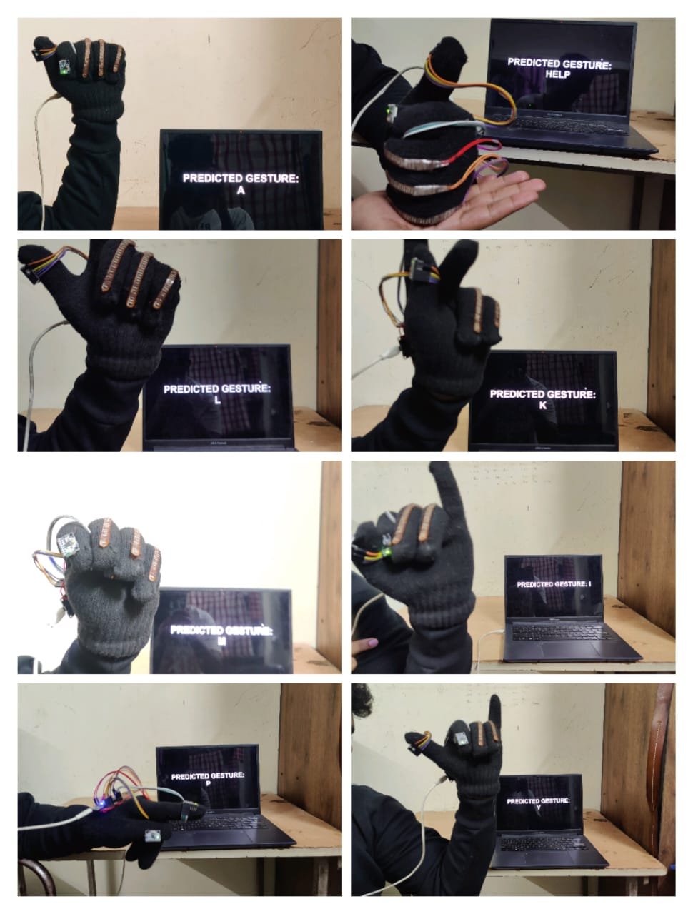
Machine learning – Part:
Gesture Samples
Organized into categories based on gestures (A to Z and relax position).
Each gesture represented by a subset of samples.
Individual Contributions
Samples identifiable by contributor, allowing analysis of individual variability.
Enables understanding of its impact on gesture recognition performance.
Balanced Distribution
Efforts made to maintain a balanced distribution across gestures and individuals.
Aims to avoid biases and ensure representative training data.
Dataset Structure
Feature Representation: Each sample is represented by features capturing hand movement and orientation.
Labeling: Ground truth labels are provided for each sample, indicating the corresponding gesture or position.
Data Format: Stored in structured formats like CSV files, facilitating easy loading and processing for machine learning experiments.
Data Collection Methodology
Data Collection Setup: Conducted in controlled environments using the Smart Glove prototype.
Quality Control: Procedures included measures to identify and discard noisy or erroneous samples.

Slide 15
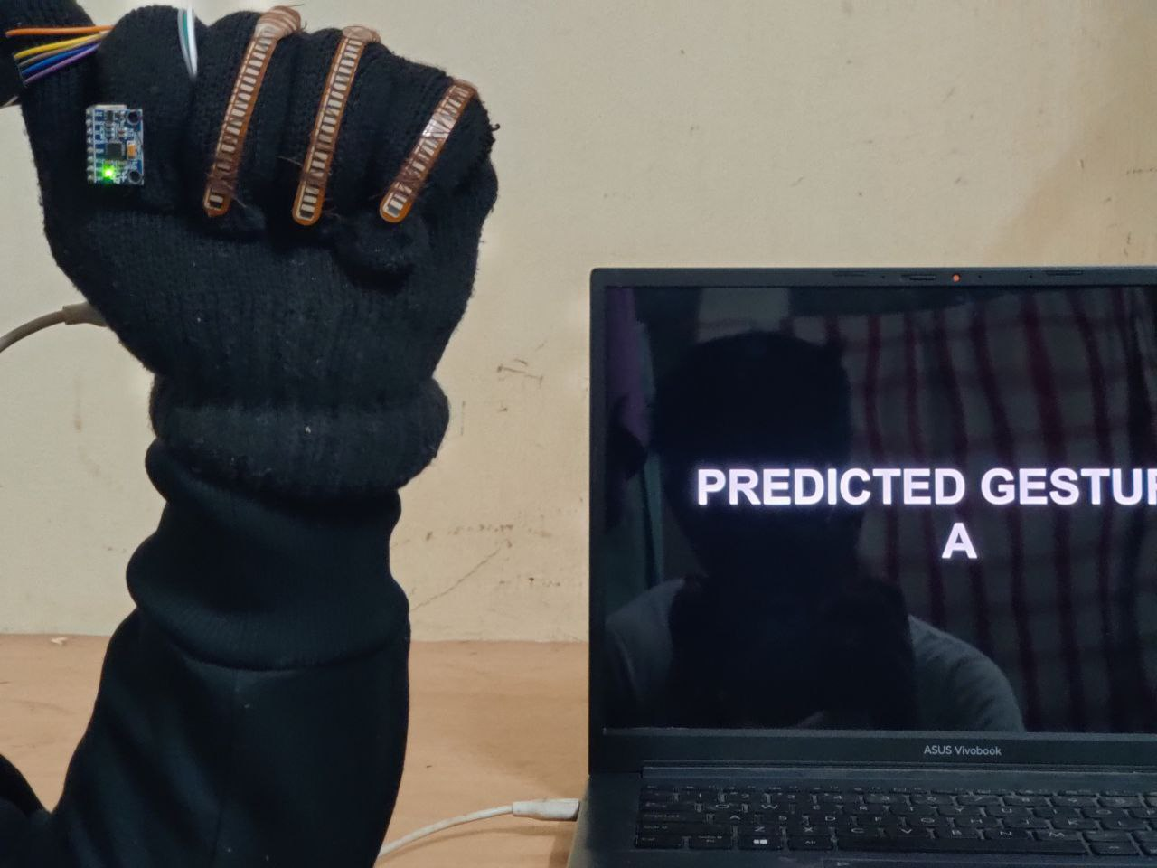
Machine learning – Part:
Predicted Value Display
Predicted values from the gesture recognition system are conveniently displayed.
Users can monitor and track predicted outcomes in real time.
Seamless User Experience
Provides users with a seamless experience for viewing gesture recognition results.
Accessible via a designated web address on any device connected to the local network.
ESP32 Web Server
Utilizes the ESP32's capabilities and web server functionality.
Offers a user-friendly interface accessible within the same network.
Easy Monitoring and Analysis
Facilitates easy monitoring and analysis of predicted values.
Empowers users to stay informed and engaged with the gesture recognition process effortlessly.

Slide 16
REFERENCES:
General Hand Gesture Recognition:
1. Li, et al. (2020): A Survey of Hand Gesture Recognition Techniques and Systems (IEEE Access)
2. Jaiswal, et al. (2019): Hand Gesture Recognition: A Literature Review (Journal of Computing and Security)
3. Han, et al. (2019): Survey on Recognition Methods for Hand Gestures Using Cameras (Journal of Visual Communication and Image Representation)
4. Wang, et al. (2021): Comparison of Hand Gesture Recognition Methods Based on Machine Learning Algorithms (Journal of Information Hiding and Multimedia Signal Processing)
5. Shah, et al. (2021): Review of Hand Gesture Recognition: Hardware and Machine Learning Perspective (International Journal of Advanced Research in Electronics and Communication Engineering)
6. Islam, et al. (2021): Vision-based Hand Gesture Recognition Techniques: A Review (Journal of Visual Communication and Image Representation)

